Slide 1

Computer Networks
Application Layer

Slide 2
Topic of the day
TCP/IP vs OSI Model
Application Layer
Application Layer Protocols

Slide 3
TCP/IP Protocol Suite
The layers in the TCP/IP protocol suite do not exactly match those in the OSI model.
The original TCP/IP protocol suite was defined as having four layers: host-to-network, internet, transport, and application.
However, when TCP/IP is compared to OSI, we can say that the TCP/IP protocol suite is made of five layers:
physical,
data link,
network,
transport, and
application.

Slide 4
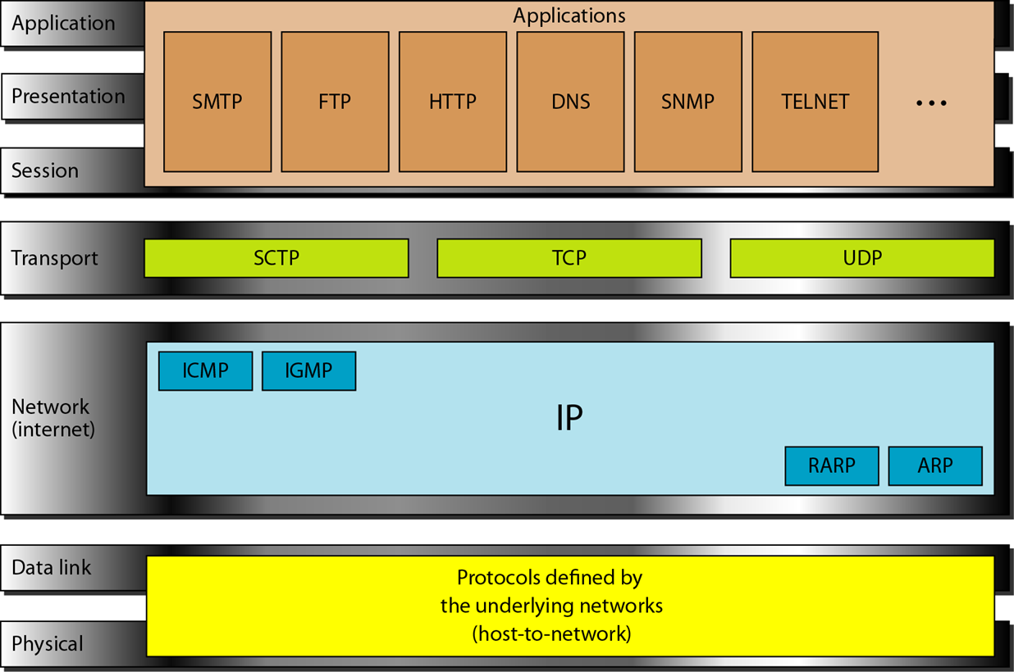

Slide 5
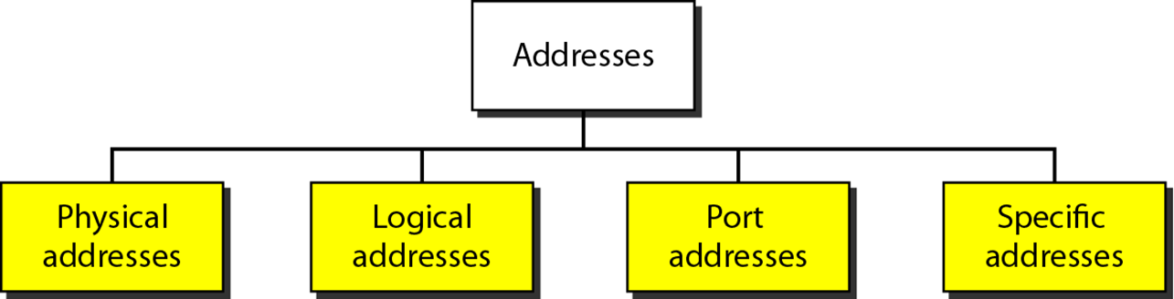
Addressing
Four levels of addresses are used in an internet employing the TCP/IP protocols:
physical (link) addresses,
logical (IP) addresses,
port addresses, and
specific addresses

Slide 6
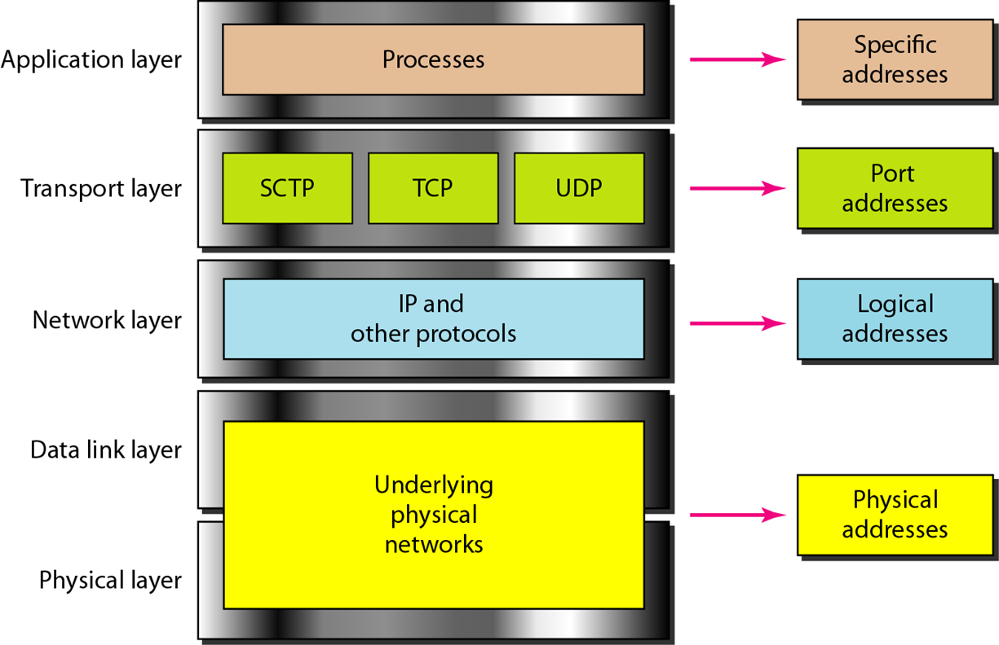
Notes:
Logical Address= IP Address
Physical Address= MAC address

Slide 7
Reading Assignment
Comparison between OSI and TCP/IP model.
Addresses and its types.
Different Addresses for different applications and networks.
Cmd-> ipconfig/all
Notes:
IP addresses changes with the change in network or sometimes after reconnecting or after a longer duration of time

Slide 8
Application Layer
The application layer is closest to the end user.
• Network applications enable users to send and receive data with ease.
• The application layer acts as interface between the applications and the underlying network.
• Application layer protocols help exchange data between programs running on the source and destination hosts.
• The TCP/IP application layer performs the functions of the upper three layers of the OSI model.
• Common application layer protocols include: HTTP, FTP, TFTP, DNS.

Slide 10
Presentation & Session Layer
The presentation layer has three primary functions:
o Format data
o Compress data
o Encrypt data
Common standards for video include QuickTime and Motion Picture Experts Group (MPEG).
Common graphic image formats are:
• Graphics Interchange Format (GIF)
• Joint Photographic Experts Group (JPEG)
• Portable Network Graphics (PNG) format

Slide 11
Presentation & Session Layer
The session layer creates and maintains dialogs between source and destination applications.
• The session layer handles the exchange of information to initiate dialogs, keep them active, and to restart sessions that are disrupted or idle for a long period of time.

Slide 12
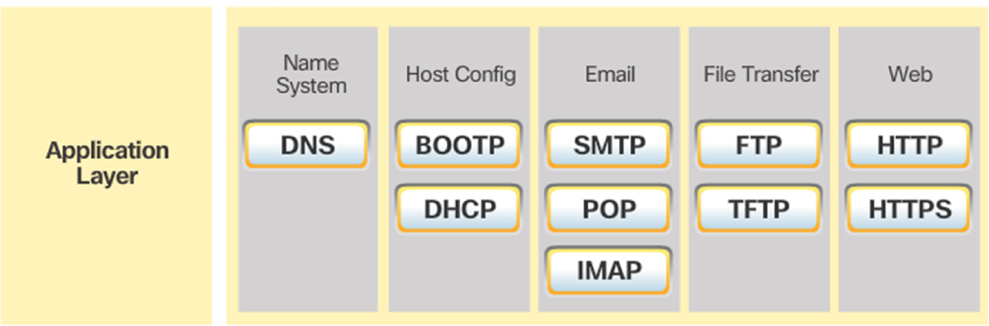
TCP/IP Application Layer
TCP/IP application protocols specify the format and control information necessary for common Internet functions.
Application layer protocols must be implemented in both the source and destination devices.
Application layer protocols implemented on the source and destination host must be compatible to allow communication.

Slide 13
How Application Protocol Interact with End User Application?

Slide 14
Two important concepts:
– Application Layer:
• The first step for getting data on to the network.
– Application Software:
• The programs used to communicate over the network.
For example:
– When displaying a web page:
• The Application Layer uses the HTTP Protocol.
• The Application Software is your browser.

Slide 15
Application Layer- Services & Ports
DNS (Domain Name System)
Resolves Internet names (URLs) to IP Addresses, port 53
Telnet, SSH (Terminal emulation, Secure shell)
access to servers and network devices, port 23, 22
SMTP (Simple Mail Transfer Protocol)
Transfer of mail messages and attachments (outgoing), port 25
POP3, POP3S (Post Office Protocol)
Transfer of mail messages and attachments (incoming), port 110, 995
IMAP
Internet Message Access Protocol, port 143
DHCP (Dynamic Host Configuration Protocol)
Assigns IP Addresses (IP, subnetmask) and other parameters (DNS, Gateway, …) to hosts, port 67, 68
HTTP(s) (Hypertext Transfer Protocol)
Transfer files that make up web pages, port 80, 443
FTP(S) ((Secure) File Transfer Protocol)
Interactive file transfer between systems, port control:21,data:21 and 3713, data:989,990

Slide 16
Application Layer Software
Within the Application layer, there are two forms of software programs or processes that provide access to the network:
– Applications
– Services

Slide 17
Application layer protocols are used by both the source and destination devices during a communication session.
The application layer protocols implemented on the source and destination host must match.
The Application Layer uses protocols that are implemented within applications and services.
– Applications provide people a way to create messages.
– Application layer services establish an interface to the network.
– Protocols provide the rules and formats that govern how data is treated.

Slide 18
Client Server Model – Traditional Paradigm
The device requesting the information is called a client.
The device responding to the request is called a server.
Client and server processes are considered to be in the application layer.
The client initiates the exchange by requesting data from the server.
The server responds by sending one or more streams of data to the client.
Application layer protocols describe the format of the requests and responses between clients and servers.
The contents of the data exchange will depend of the application in use.
Email is an example of a Client-Server interaction.
Several traditional services using this paradigm includes World Wide Web (www) and its vehicle HyperText Transfer Protocol (HTTP), File Transfer Protocol FTP, Secure Shell SSH etc.
Notes:
Application Layer paradigm: 2

Slide 20
Peer-to-Peer Model - New Paradigm
In the peer-to-peer (P2P) networking model, the data is accessed without the use of a dedicated server.
Two or more computers can be connected to a P2P network to share resources.
Every connected end device (a peer) can function as both a server and a client.
The roles of client and server are set on a per request basis.

Slide 21
Some P2P applications use a hybrid system.
In hybrid P2P, resource sharing is decentralized.
Indexes that point to resource locations are stored in a centralized directory.
In a hybrid system, each peer accesses an index server to get the location of a resource stored on another peer.

Slide 22
Common P2P networks include: eDonkey, G2, BitTorrent, Bitcoin, Skype.
Many P2P applications allow users to share pieces of many files with each other at the same time.
A small torrent file contains information about the location of other users and tracker computers.
Trackers are computers keeping track of the files hosted by users.
This technology is called BitTorrent.
There are many BitTorrent clients, including BitTorrent, uTorrent, Frostwire, and qBittorrent.

Slide 23
Well Known Protocols & their Working

Slide 24
HTTP & HTML
A web address or uniform resource locator (URL) is a reference to a web server.
A URL allows a web browser to establish a connection to that web server.
URLs and Uniform Resource Identifier (URIs) are the names most people associate with web addresses.
The URL http://cisco.com/index.html has three basic parts:
o http (the protocol or scheme)
o www.cisco.com (the server name)
o index.html (the specific filename requested)
Using DNS, the server name portion of the URL is then translated to the associated IP address before the server can be contacted.
Notes:
Hypertext Transfer Protocol and Hypertext Markup Language

Slide 25
The browser sends a GET request to the server’s IP address and asks for the index.html file.
The server sends the requested file to the client.
The index.html was specified in the URL and contains the HTML code for this web page.
The browser processes the HTML code and formats the page for the browser window based on the code in the file.

Slide 26
HTTP & HTTPS
HTTP
o Is a request/response protocol.
o Has three common message types: GET, POST, PUT.
o Is not secure. Messages can be intercepted.
o port 80
HTTPS
o uses authentication and encryption to secure data.
o port 443

Slide 27
Email Protocol
Email is a store-and-forward method of sending, storing, and retrieving electronic messages.
Email messages are stored in databases on mail servers.
Email clients communicate with mail servers to send and receive email.
Mail servers communicate with other mail servers to transport messages from one domain to another.
Email clients do not communicate directly when sending email.
Email relies on three separate protocols for operation: SMTP (sending),POP (retrieving), IMAP (retrieving).

Slide 28
SMTP Operation
SMTP message formats require a message header and body.
The body can contain any amount of text.
The header must have a properly formatted recipient email address and a sender address.
An SMTP client sends an email by connecting to a SMTP server on port 25.
The server receives the message and stores it message in a local mailbox or relays the message to another mail server.
Users use email clients to retrieve messages stored on the server.
IMAP and POP are two protocols commonly used by email clients to retrieve messages.

Slide 29
POP Operation
Messages are downloaded from the server to the client.
The server listens on port 110 TCP for client requests.
Email clients direct their POP requests to mail servers on port TCP 110.
The POP client and server exchange commands and responses until the connection is closed or aborted.
POP allows for email messages to be downloaded to the client’s device (computer or phone) and removed from the server.
There is no centralized location where email messages are kept.
A downloaded message resides on the device that triggered the download.

Slide 30
IMAP Operation
IMAP is another protocol used to retrieve email messages.
Allows for messages to be displayed to the user rather than downloaded.
The original messages reside on the server until manually deleted by the user.
Users view copies of the messages in their email client software.
Users can create a folder hierarchy on the server to organize and store mail.
That file structure is displayed on the email client.
When a user decides to delete a message, the server synchronizes that action and deletes the message from the server.
Notes:
Internet Message Access Protocol (IMAP) means that all of your email is saved on your Internet Service Provider's servers. If you are using IMAP, you can run an email program at home and an email program at work and both programs will access the same set up messages and folders.
By default, the IMAP protocol works on two ports: Port 143 – this is the default IMAP non-encrypted port; Port 993 – this is the port you need to use if you want to connect using IMAP securely.

Slide 31
Next Class
IP Addressing Protocols
DNS
File Sharing Protocols
DHCP
FTP

Slide 32
References
https://www.siteground.com/tutorials/email/protocols-pop3-smtp-imap/#:~:text=By%20default%2C%20the%20IMAP%20protocol,to%20connect%20using%20IMAP%20securely.

